Slide 1
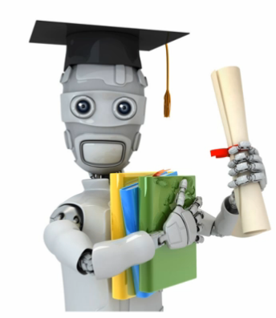
Machine Learning for Developers

Slide 2
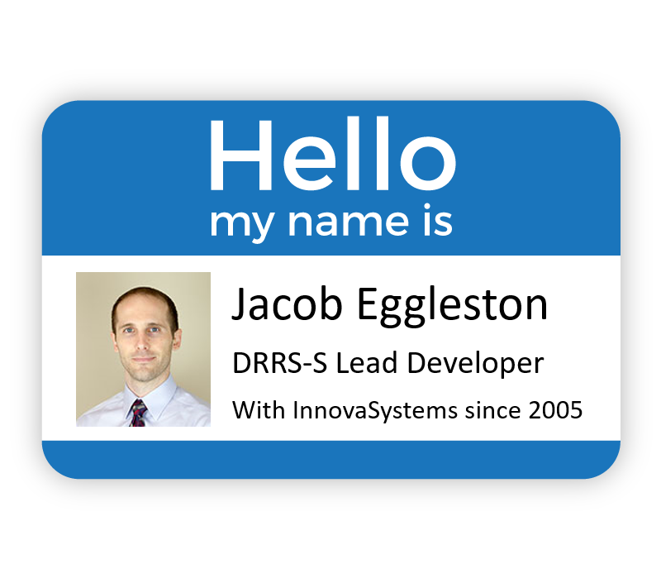
Slides and resources available at:
https://github.com/chilimangoes/Innova_ML_Presentation

Slide 3

Agenda
See ML4PMs MM:SS
Why machine learning?
What is machine learning?
What kinds of problems can ML solve?
Tools, frameworks, languages
What machine learning isn’t
How can I enable ML on my project(s)?
Pitfalls and challenges
ML4PMs 18:20
Notes:
Takeaway: High-level intuition of how the two most popular ML algorithms work

Slide 4
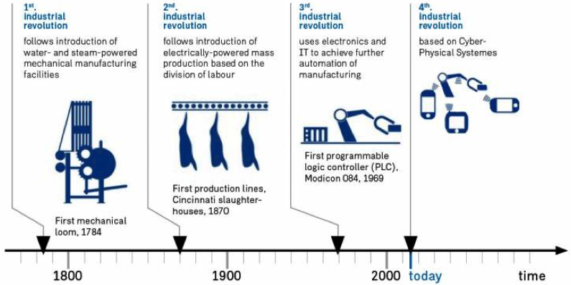
Why Machine Learning?
See ML4PMs 3:07
“Mobile computing, inexpensive sensors collecting terabytes of data, and the rise of machine learning that can use that data will fundamentally change the way the global economy is organized.” (Forbes Magazine)
Notes:
We're in the early stages of what many people are anticipating to be a fourth industrial revolution. Like the revolutions before it, this one is poised to transform the way we work and do business in ways that we can't even comprehend yet.
I've heard AI referred to as "the new electricity" and I would agree with that categorization. Most of us alive today probably can’t imagine our lives without electricity? Can you imagine your job, or any job, without electricity?

Slide 5
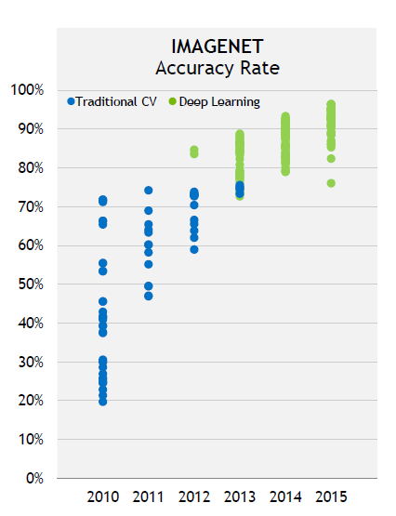
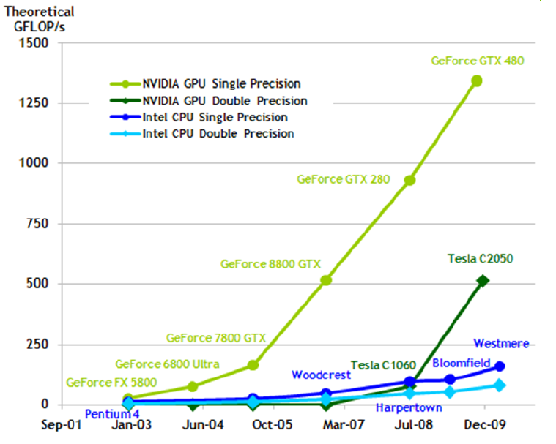
Why Now?
See ML4PMs 7:37
Current explosive trend in ML driven by:
Massive amounts of data
Massive amounts of computing power
End-to-end learning
Notes:
So now, let's talk a little about the background and timing of all of this...
Most of the core ideas that are hot in ML right now have been around since the 80’s, or even earlier. Things like neural networks, convolutional networks, etc have been around for decades. What's different now is that it's relatively easy to get access to the massive amounts of data and computing power needed to really make these algorithms start to see their potential.
* End-to-end learning - without tedious feature engineering
* Human-level performance in a wide array of tasks
Inflection Points:
* Mid 2000's - acceleration using consumer-grade graphics cards
* 2012 - AlexNet crushes state-of-the-art computer vision competition using an end-to-end deep neural network
* 2015 - Deep Learning beats human performance at ImageNet
In the mid 2000's, a series of papers on using cheap consumer graphics cards to train machine learning models allowed researchers to train large models that previously would have required access to expensive supercomputers. This kicked off a flurry of research activity and steady improvements to the state-of-the-art in various sub-fields of ML.
Then in 2012, a team of ML researchers from the University of Toronto, led by Alex Krizhevsky, blew 30 years of computer vision research completely out of the water with a deep neural network called AlexNet in a competition called ImageNet. Before AlexNet, teams of researchers with PhDs in computer vision would spend thousands of hours tweaking features for their computer vision models to improve accuracy by fractions of a percent. AlexNet used end-to-end deep neural network to learn its own features and cut the error rate almost in half from the best hand-coded algorithm (15% vs 26% error). This kicked off an AI arms race and three years later, in 2015, ML achieved a 96% accuracy rate on the ImageNet competition, beating humans for the first time.

Slide 6
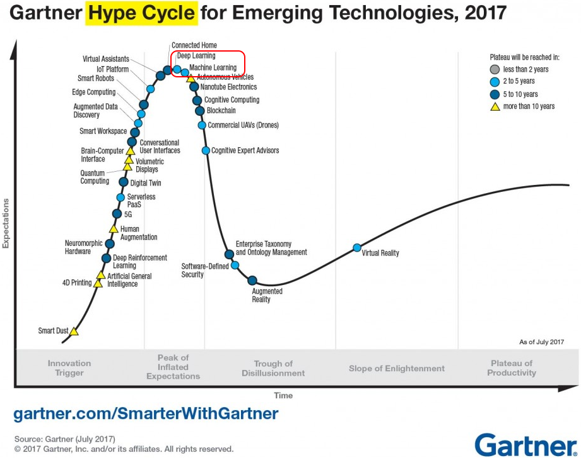
Why Now?
Notes:
My prediction: many people are overestimating short-term impact and underestimating long-term impact.
Addendum: we’re probably in for some kind of ML/AI bubble burst soon. But don’t let that fool you into thinking that ML is just a fad or that it won’t be massively transformative. Remember the dot com bubble? No one with any sense would suggest that the internet hasn’t gone on to be incredibly transformative in ways we couldn’t even anticipate at the height of that bubble.

Slide 7
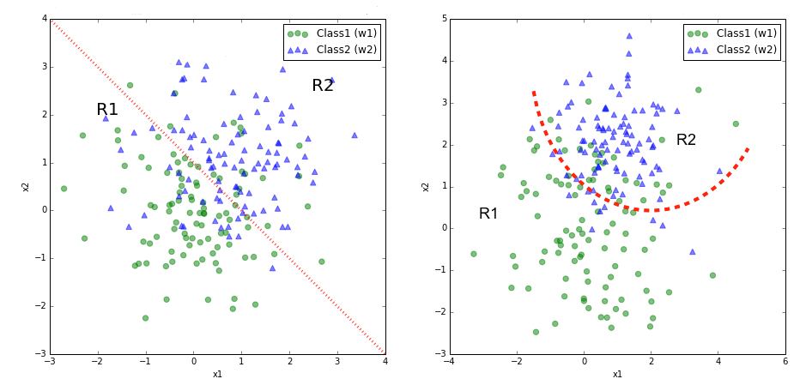
What Is Machine Learning?
ML systems learn programs from data
“It's just math”
Notes:
Creates programs that do something useful, without you having to figure out exactly how to do it.
Compare that to the usual way we create programs, where we need to be able to code every step (if this happens, then do that, then that, etc...).
It’s just math
(but you don’t necessarily need a lot of math to get started using it)

Slide 8
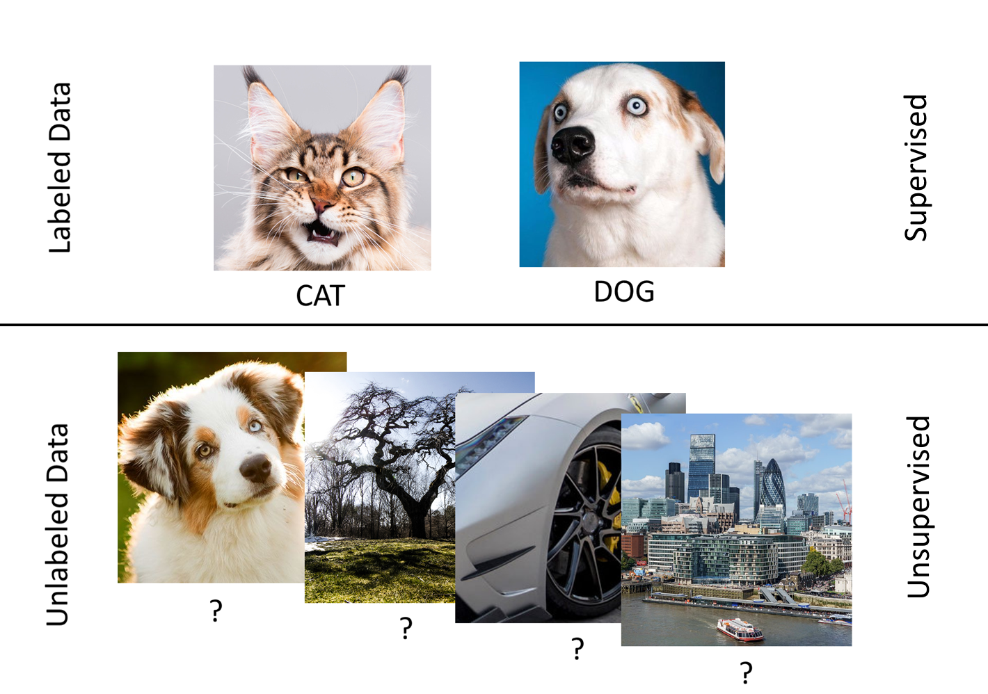
What Is Machine Learning?
Supervised vs Unsupervised / Labeled vs Unlabeled
Notes:
Before we get into some of the nuts and bolts, we need to understand the difference between labeled data and unlabeled data. With labeled data, each entry is given a correct answer of what you would expect the output of the machine learning algorithm to produce. For example, if you have a bunch of pictures of cats and dogs, and each picture is labeled as either "cat" or "dog", that's labeled data. Unlabeled data would be, for example, if you just had a bunch of random pictures with no information about what is in each picture. The kinds of things that machine learning can do are very different, depending on whether you can give an algorithm the "correct" answers that you expect it to produce.
Generally speaking:
Supervised – Labeled Data
Unsupervised – Unlabeled Data
A couple others we aren’t really going to cover:
* Semi-Supervised
* Reinforcement Learning

Slide 9
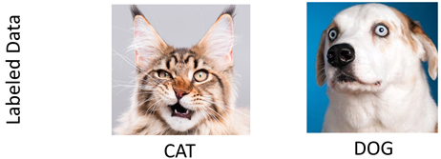
What Is Machine Learning? Supervised Learning
You give an algorithm a bunch of examples
It tries to guess what the answer is
You tell it what the correct answer is
It adjusts its programming slightly to give a better answer (reduce the error)
Rinse and repeat until you run out of examples or your accuracy levels off

Slide 10
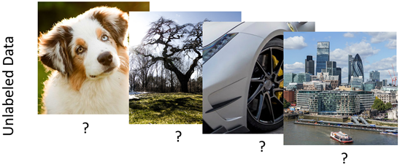
What is Machine Learning? Unsupervised Learning
Looks for patterns in data
You show an algorithm a bunch of data, but there are no "correct" answers
It examines the data for underlying structure and patterns
Notes:
* Unsupervised – looking to do something useful with unlabeled data

Slide 11
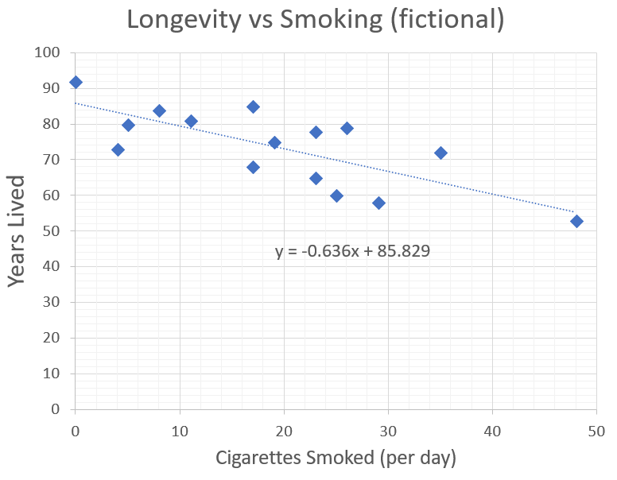
What is Machine Learning? Line/Curve Fitting
Notes:
Explain fitting a line
This is an example of a regression problem: given a value on the X axis, try to predict Y

Slide 12
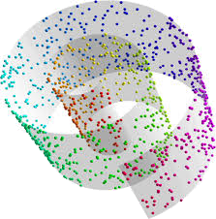
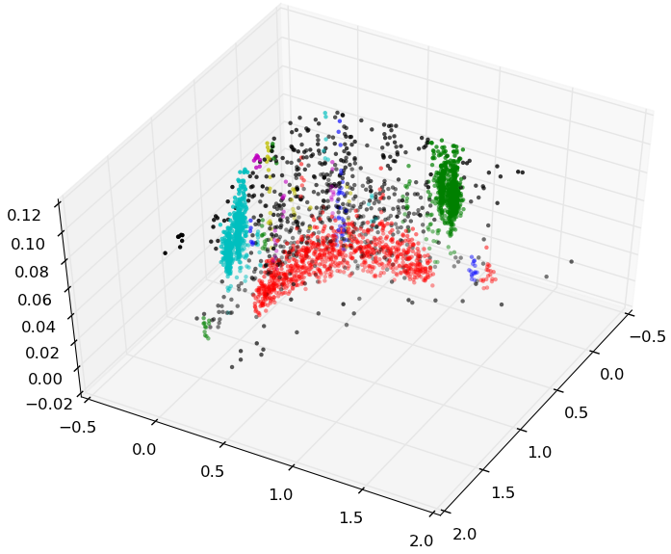
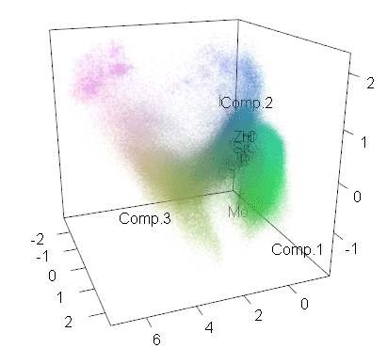
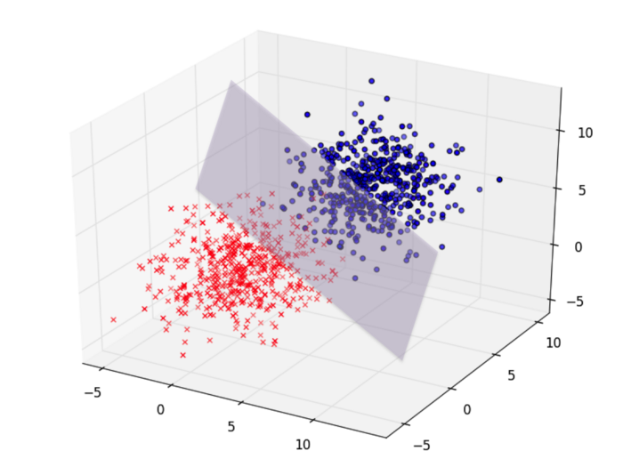
Multiple Dimensions

Slide 13
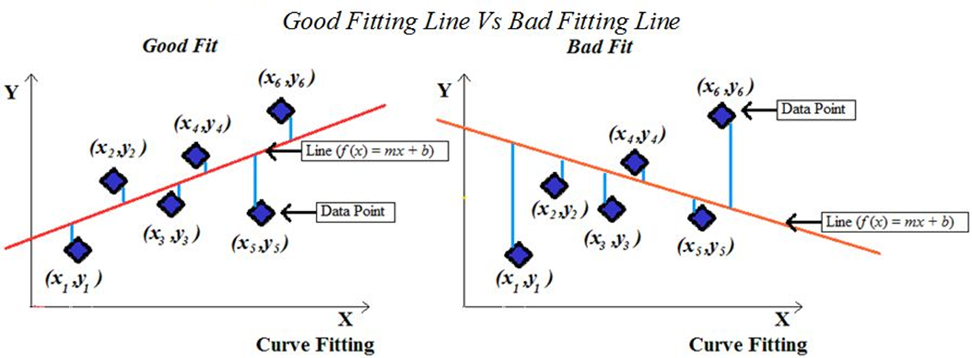
Line Fitting – Mean Squared Error

Slide 14
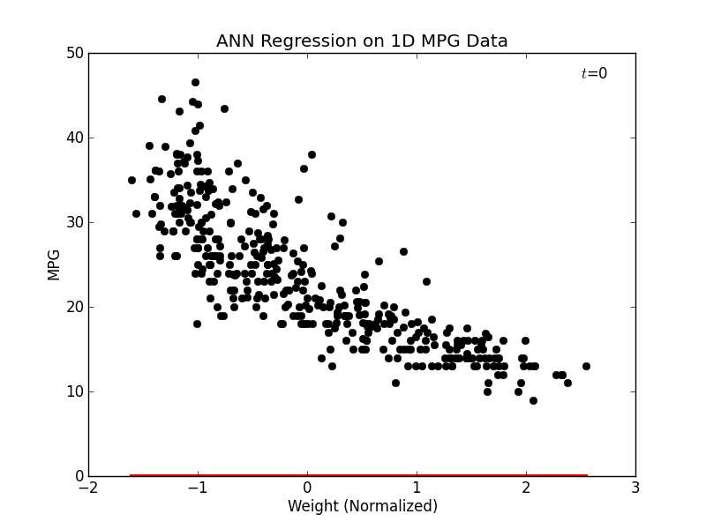
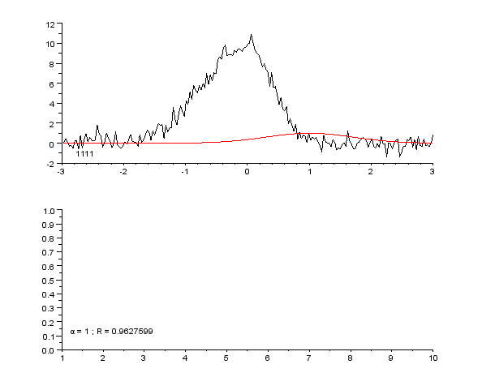
Minimizing Error - Example

Slide 15
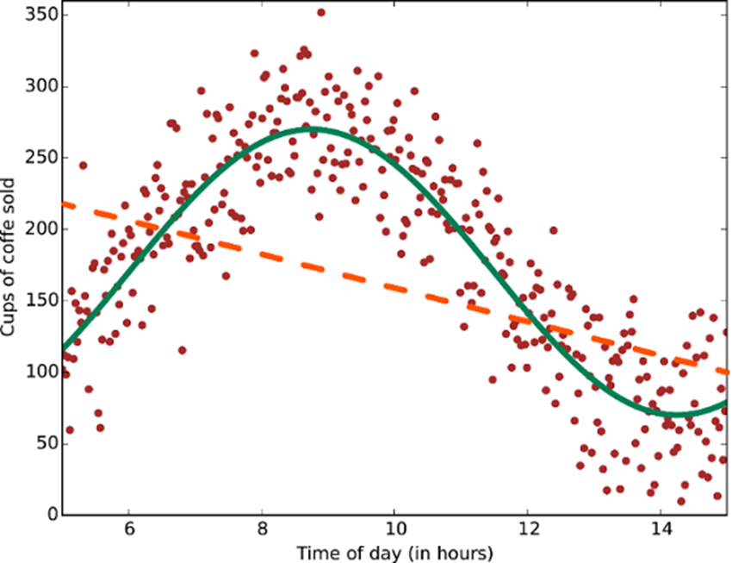
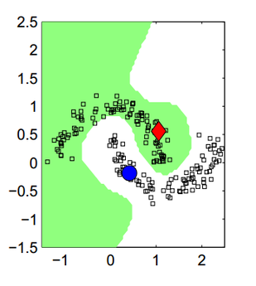
Non-Linear Predictions and Boundaries

Slide 16
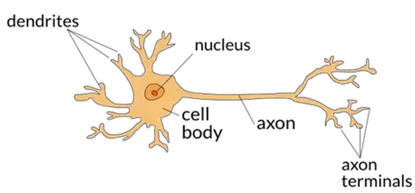
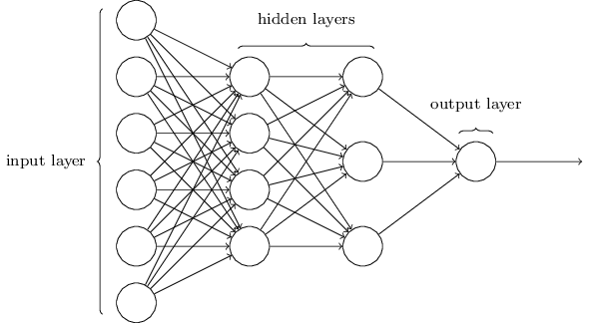
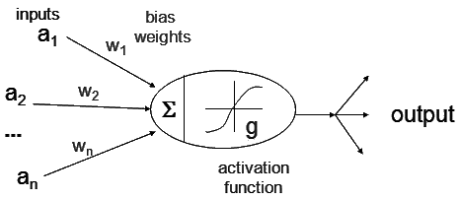
Neural Networks
Notes:
ANNs -> Loosely inspired by neural networks in biology
Allow massive nonlinearity in high-dimensional problem spaces
Universal function approximators

Slide 17
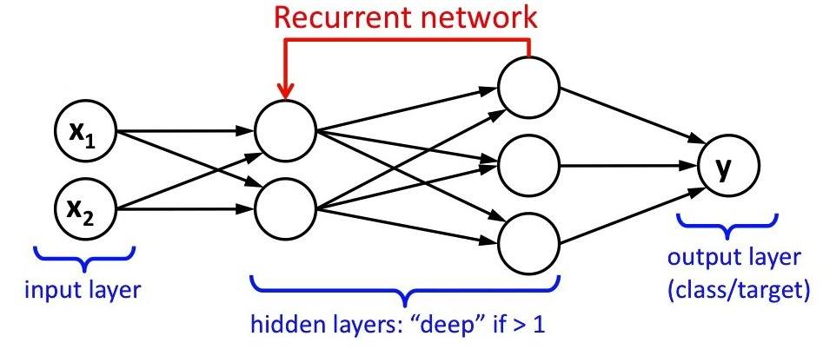
Neural Networks – Recurrent

Slide 18
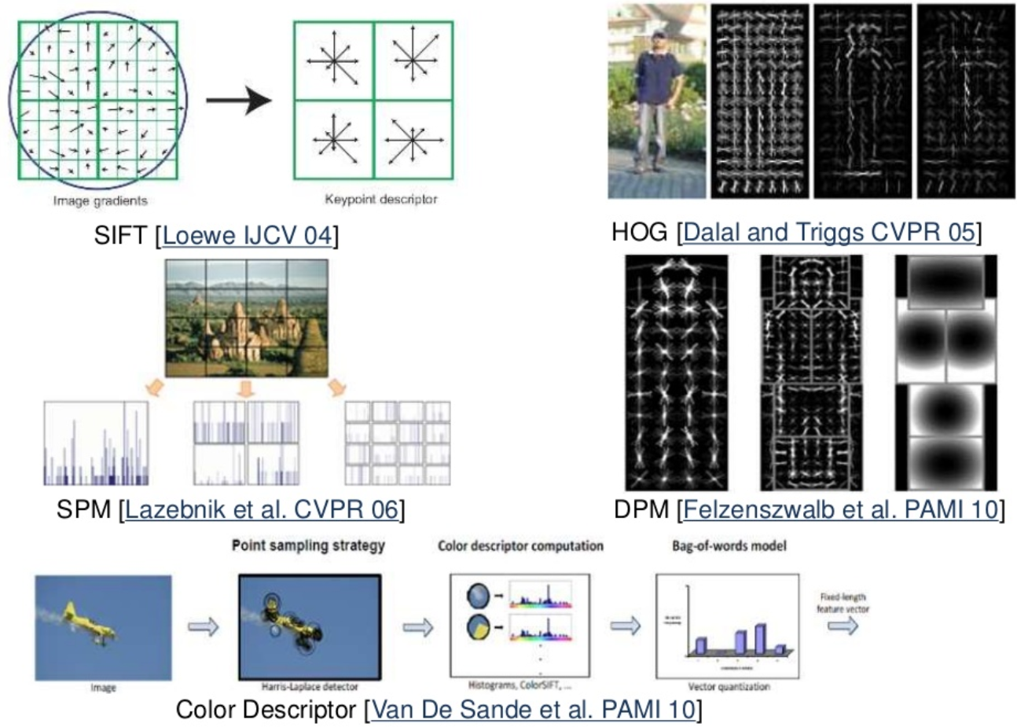
Deep Learning – Background

Slide 19

Deep Learning Automated Feature Extraction

Slide 20
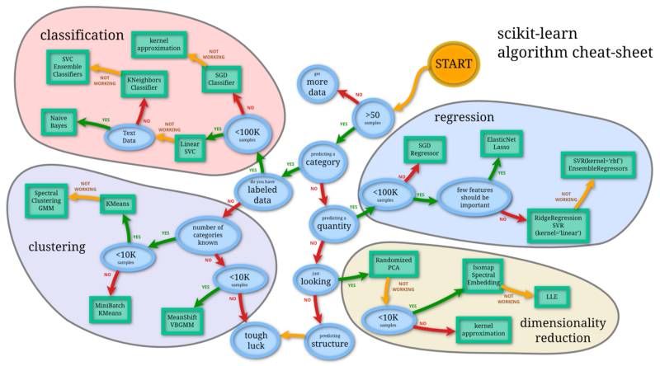
What Can Machine Learning Do?
See ML4PMs 18:20
ML Algorithm Types
Classification
Regression
Ranking
Recommendation
Clustering
Embedding, Dimensionality Reduction
Anomaly detection
Etc…
Notes:
Ok, so what kinds of problems can ML algorithms solve?
These are the major ML algorithms I'm going to cover. But there are others.

Slide 21
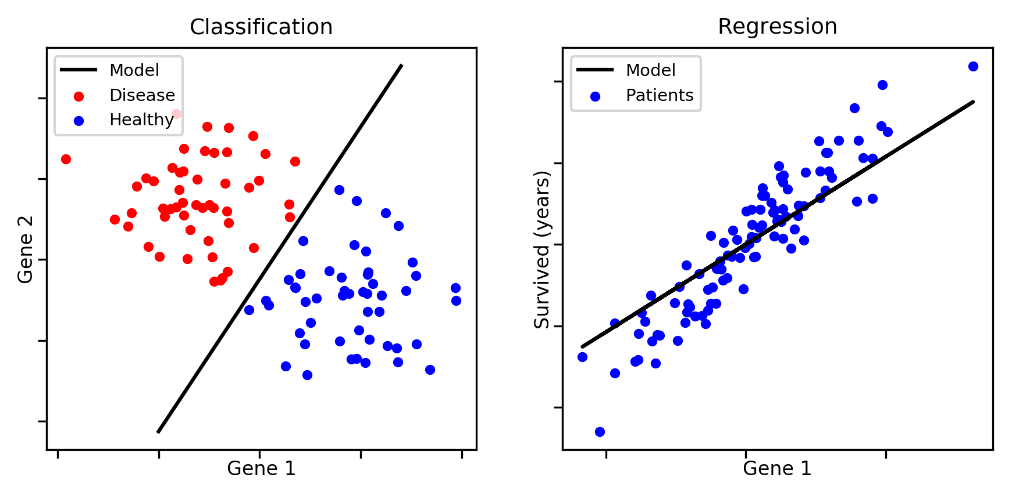
Classification vs Regression

Slide 22
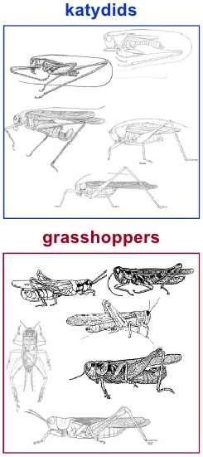
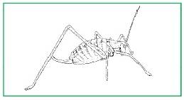
Classification - Example
Let’s use ML to decide if this is a grasshopper or a katydid…

Slide 23
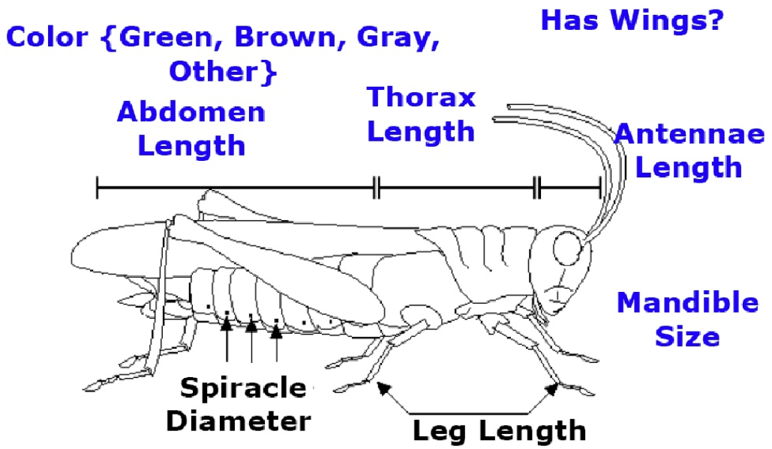
Classification - Example
How do I put a grasshopper in my computer?

Slide 24
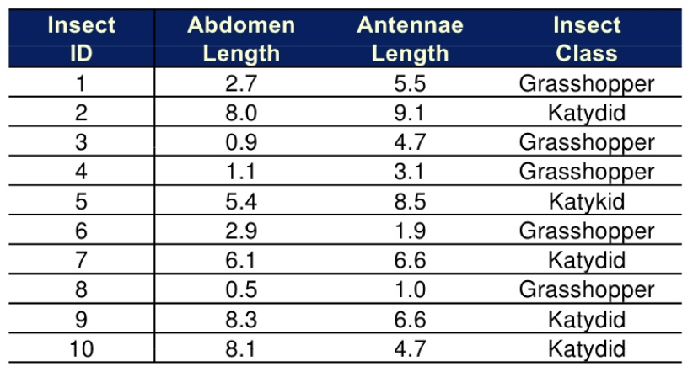
Classification - Example

Slide 25
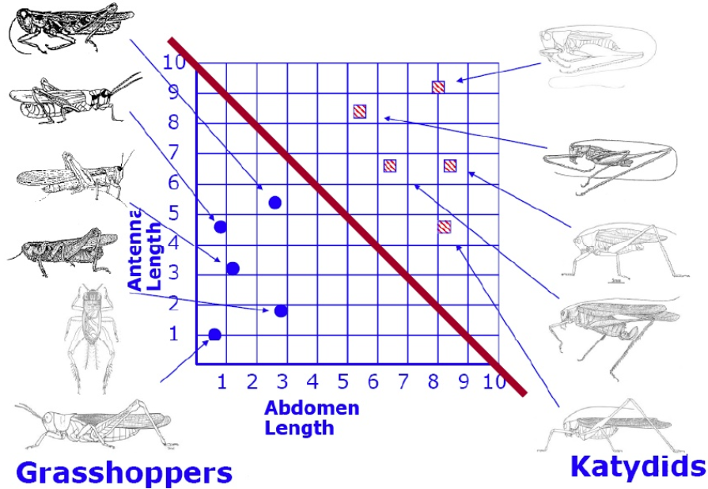
Classification - Example

Slide 26
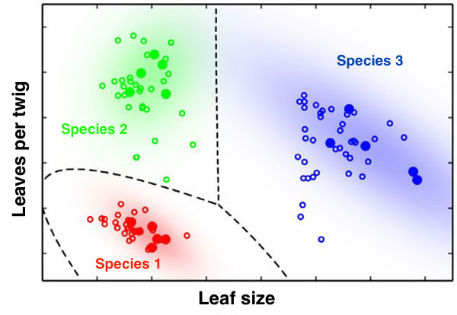
Multiclass Classification

Slide 27
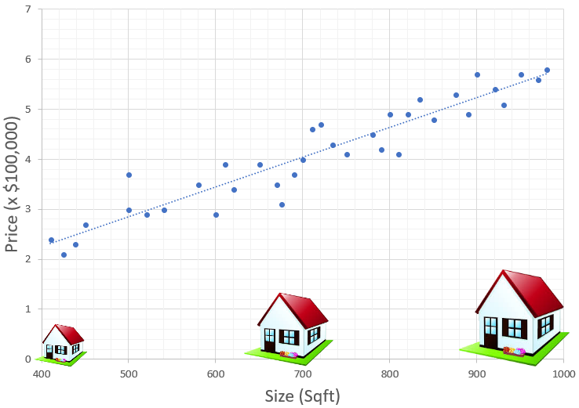
Regression - Example

Slide 28
Classification vs Regression

Slide 29
What Can Machine Learning Do?
Transform: Make data easier to process or visualize
Embedding: transform complex, unstructured data into numbers
Ex: free-form text, GFM graphs
Dimensionality Reduction: reduce data down to its “essence”
Important for things like visualization
Notes:
Embedding: this a broad category of algorithms who's general purpose is to process some input data in a format that doesn’t work well for other typical applications of machine learning (e.g. free text or GFM data). Often, these algorithms are used in a pipeline to help facilitate other types of machine learning, visualization, or analysis.

Slide 30
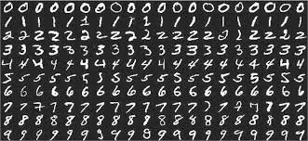
Dimensionality Reduction - Example
MNIST – Example dataset of handwritten digits
28 x 28 = 784 pixels, each 0-255
Notes:
Example… (background/setup for next slide)

Slide 31
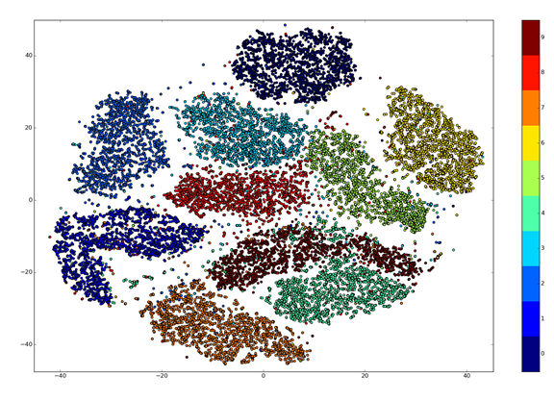
Dimensionality Reduction - Example
MNIST – 784 dimensions to 2, using T-SNE
Notes:
NOTE: Interesting article on using autoencoders for dimensionality reduction
http://nikhilbuduma.com/2015/03/10/the-curse-of-dimensionality/

Slide 32
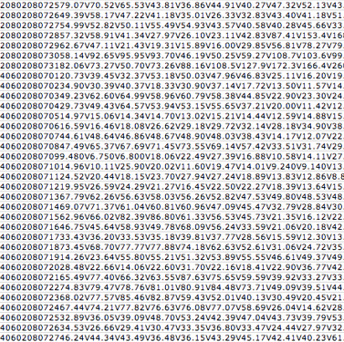
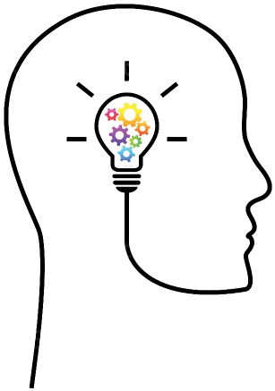

What to look for?
Many of the best opportunities for ML are:
Data driven
Difficult to codify into rules (i.e. require "intuition")
But are tedious for a human to perform

Slide 33
What to look for?
Examples:
Can we answer this question automatically, based on some data?
Can we automatically transform some input data into some output?
Can we automatically associate thing A with thing B?
Basically, if the question is "can we automatically do ______ based on some data?" then it might be a good candidate for ML
(Assuming, of course, that you have the data)
Notes:
(But knowing for sure whether a problem is a good candidate for ML can be hard. If you're not sure, feel free to ask.)

Slide 34
What Machine Learning Isn't
Data Analytics
Data Science
BI
Graphs
AI
Panacea
Notes:
I avoid the term AI because it’s loaded, means different things to different people, and often carries a connotation of “magic.”
Note: while the above may not be machine learning, that doesn't necessarily mean ML can't make a useful contribution to them, in some cases. For example, using graph embedding, dimensionality reduction or clustering to enable 2D/3D visualization and exploration of highly complex data or data that wouldn't otherwise be amenable to numerical analysis (e.g. GFM data).
Note 2: this is not meant to discourage anyone from suggesting "dumb" ideas. As noted on the previous slide, knowing for sure whether a problem is a good candidate for ML can be hard, even for someone with a good deal of experience. And even a "bad" idea could spark a related "good" idea. So don't be afraid to ask.

Slide 35
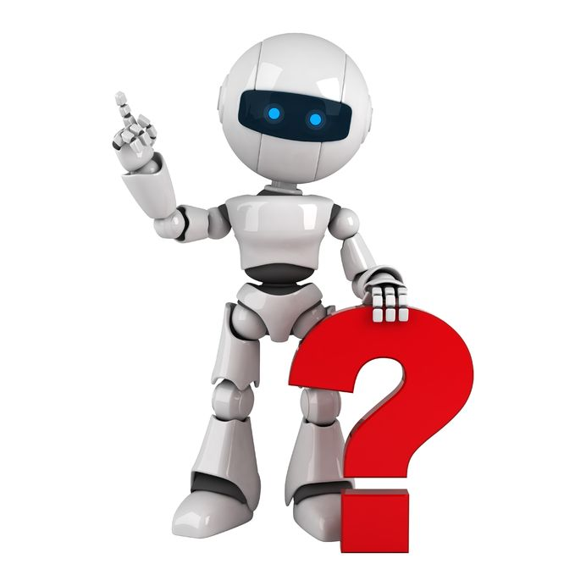
How Do I Enable ML On My Project?
See ML4PMs 38:11

Slide 36

Enabling ML On My Project…
Rule #1: COLLECT. ALL. THE. DATA.
Notes:
We're not just talking about acquiring new data feeds from other systems (ala DRRS-S). This is also about generating NEW data. This is about tracking EVERYTHING that happens in our systems. Even seemingly simple user interactions can be valuable sources of data for ML algorithms.

Slide 37

Enabling ML On My Project…
Rule #1: COLLECT. ALL. THE. DATA.
Vectorize the world
Google Maps places you visited
Facebook recommendations
Or really, anything you do on Facebook, or Google, phone, etc...
Notes:
For example, Instagram’s friend recommendations allow users to follow or hide the suggested contacts, and Foursquare allows users to fix the places that it automatically detected users had visited. In doing so, both of these allow users to engage with the ML algorithm’s output, and provide new data - both positive (yes, follow!) and negative (no, hide!) examples. These can then be fed back to improve the algorithm.
In our world, this could be things like tracking user searches, followed by what result(s) were clicked on and how far down the list they were. In a readiness report workflow, you could record snapshots of reports as they're being edited, along with the Draft/Completed status or Y/Q/N status. Later on, this information might be used to automatically suggest a status, identify reasons for a degraded readiness rating, or predict future readiness levels. [This is a somewhat contrived example, but meant to get the creative juices flowing about the kinds of things they could be looking for.]
In short, if you want to do the kinds of things with data that companies like Google and Facebook are able to do (for better or worse), then you need to start thinking about data like they do, even if on a smaller scale.

Slide 38
Pitfalls and Challenges
See ML4PMs 42:48
Not enough data (See: Rule #1)
Lack of buy-in/engagement
Lack of domain and/or technical expertise
Bad/biased data
Bad product design
Classified data
Etc...
Notes:
We've already talked about the first item, so let's cover some of the other ways ML projects can fail...
Buy In: Someone mentioned during Arpita's presentation that often times, our users don't necessarily want to see the story that the data is telling them. User/customers/sponsors may not be able to see the value in data-driven decision making. This can be a tough problem and it may require some selling.
Expertise: We need collaboration between project SMEs, data SMEs and the people running the ML algorithms.

Slide 39



Tools, Tools, Tools
Languages
Python (esp. Anaconda)
Maybe also R

Slide 40


Tools, Tools, Tools
General ML Frameworks
Scikit-learn (http://scikit-learn.org/)
Accord .NET (http://accord-framework.net/)
ML.NET (http://dot.net/ml/)

Slide 41





Tools, Tools, Tools
Deep Learning Frameworks
Tensorflow (Google)
Torch/PyTorch (Facebook)
Caffe2
CNTK (Microsoft)
Keras (One ring to rule them all)
Notes:
Honorable mention:
- Theano and www.deeplearning.net

Slide 42
Tools, Tools, Tools
Other
Jupyter / IPython Notebooks
Nvidia GPUs / CUDA
Linux
Virtualization/Docker
Azure
Notes:
Unfortunately, OpenCL just doesn’t have the level of support that CUDA has in ML libraries, so Nvidia GPUs are pretty much the only game in town.
Same for Linux vs Windows.
GPU acceleration does not work correctly in products like VMWare Workstation and Docker, making ML slooooow.

Slide 43
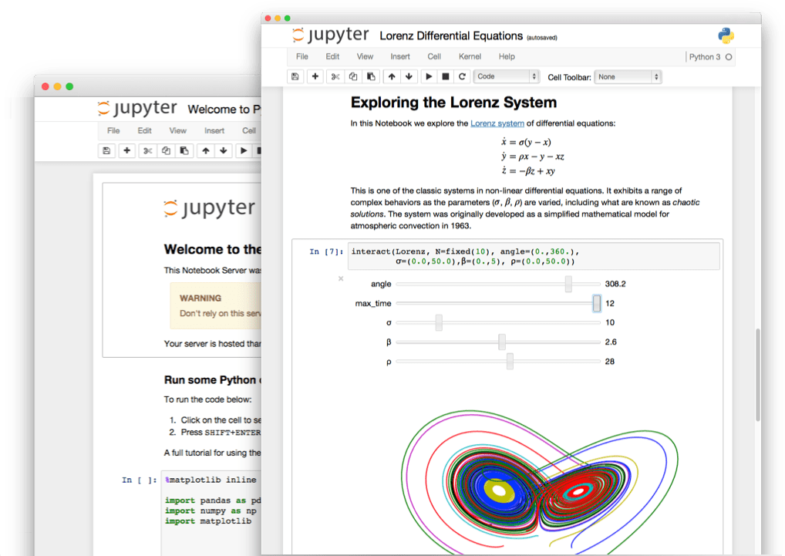
Demo - Jupyter

Slide 44

Summary
Be on the lookout for opportunities
Collect more data
Be aware of pitfalls, but don’t let them discourage ideas
Encourage people to get involved - even a little helps
Subject matter experts
Existing ML expertise
People interested in learning to apply ML
Data acquisition and preparation (important!)
Contact: Jacob Eggleston or Jim Kilty
https://tinyurl.com/innova-ml
https://github.com/chilimangoes/Innova_ML_Presentation

Slide 45
Supplemental slides…

Slide 46
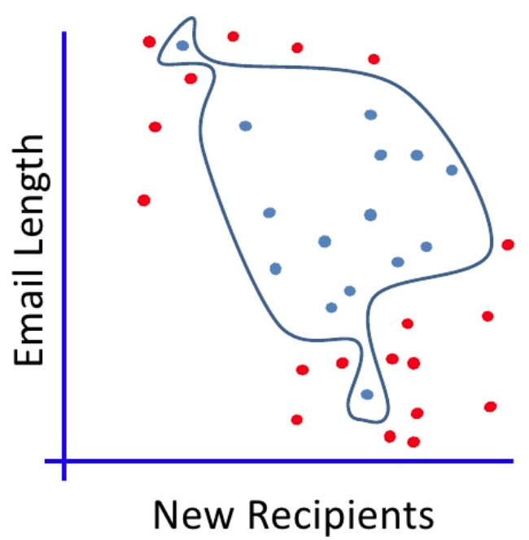
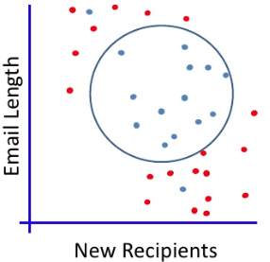
Overfitting / Underfitting
Notes:
Overfitting vs Underfitting

Slide 47
What is Machine Learning?
Semi-Supervised:
Basically, supervised learning but augmented with unlabeled data to improve accuracy
Fairly advanced and still not used extensively, but likely to become much more important in the future

Slide 48
What is Machine Learning?
Reinforcement Learning:
There isn't a "correct" answer for each output. Instead, occasional feedback is given to the algorithm about whether it's doing a good job or not. (Technical term: sparse rewards)
Often used for learning behavior (e.g. robots, self-driving cars)

Slide 49
What is Machine Learning?
Recap:
4 categories: supervised, unsupervised, semi-supervised, and reinforcement learning
Generally speaking, the important ones to remember are
Supervised - learning to predict a "correct" answer
Unsupervised - looking for patterns in data
Notes:
Semi-supervised and reinforcement learning can be thought of as building on top of supervised learning, for specific scenarios, like sparse feedback/rewards and lack of training data.

Slide 50
What Can Machine Learning Do?
Ranking: Help users find the right thing when they search
Obvious example: Google search results
But can apply to all kinds of areas
UEX Warning: can confuse users in some contexts
Notes:
Warning: be careful from a UEX perspective; users often expect search results to be in some deterministic order, like alphabetical

Slide 51
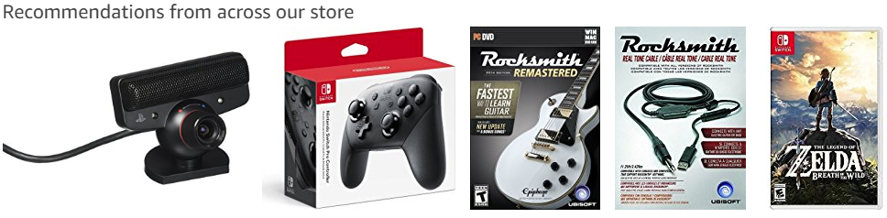
What Can Machine Learning Do?
Recommendation: Suggest something to a user
Obvious examples: Amazon, Netflix

Slide 52
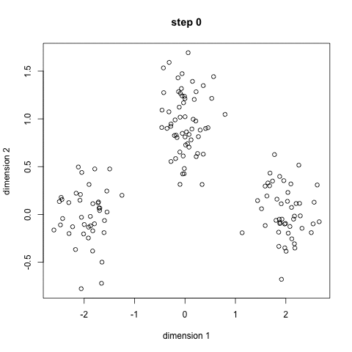
What Can Machine Learning Do?
Clustering:
Try to automatically group similar things together
Notes:
Divide customers into 10 categories, based on purchasing habits
Find a replacement unit or piece of equipment to perform a task, based on GFM data, location, etc
Look for similarities between different GFM hierarchies

Slide 53
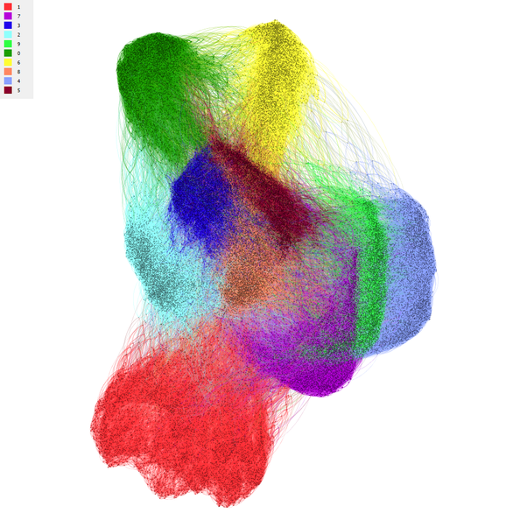
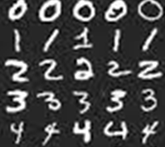
Clustering - Example
Spectral clustering of MNIST digits
Notes:
An example of spectral clustering of MNIST digits
Source: https://www.quora.com/What-is-an-intuitive-explanation-of-spectral-clustering-in-the-context-of-machine-learning
28 x 28 = 784 pixels
each pixel = 0-255 grayscale

Slide 54
What Can Machine Learning Do?
Anomaly Detection: Finding uncommon or out-of-place things
Trending lists (Twitter, FB)
Defect detection
Intrusion detection
Fraud detection
Look for anomalies in flight data
Look for missing attributes or links in GFM data
"One of these things is not like the others"

